Slide 1
Airport delays
How to avoid the worst part about air travel today . . .

Slide 2
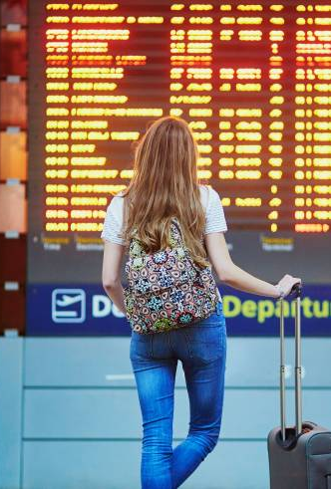
Airport delays: theme
If you’re lucky, you’ve traveled before via air without delays. It’s awesome.
Other times when luck is not on your side, you’ve endured air travel delays. They suck.
But what if luck was removed from the equation? What if we could build a tool that helped users identify and avoid airport delays?
Using data from the Bureau of Transportation Statistics, we obtained a year’s worth of air travel delay data based on the reporting from 18 major airlines and 30 major airports across North America.
The resulting site offers multiple visualizations showing users the various types of delays, when and where they’ve occurred, both in terms of quantity and duration.

Slide 3
Coding approach
Our dashboard page displays multiple charts that update from the same data.
The ex-class JS Library we chose was anime.js.
It animates the title of our page.
We created a SQLite database using a csv file downloaded from the Bureau of Transportation Statistics’ web site.
Using flask, we call that data into a python file, where we extract and prepare all the data and variables needed to build the charts.
We constructed the charts in a separate JavaScript file for display on our index.html page.

Slide 4
Data MUnging
The date-related data was presented in two columns, one holding the year, the other holding the name of the month in which each delay was reported. The two couldn’t be concatenated in Python (one is a string, the other an integer).
Used python to get the mean and sum, then join two data frames
Used group by to find values across multiple categories
Used Bootstrap to build the page
Our animated logo required code in the html, CSS and JavaScript
Changed the cursor to an airplane for fun
We originally created our database in PGAdmin, but it was not easily usable from that point. So, we ended up using Jupyter Notebook and Pandas to push it into a SQLite database.

Slide 5
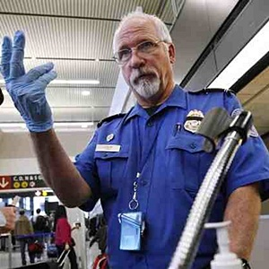
Insights gained
Be nice to the TSA. Security delays account for only a small fraction of the time spent ‘in delay.’
Don’t worry about weather – it happens! And it only accounts for around 5% of all time spend ‘in delay.’ However, if you can help it, avoid SkyWest and Chicago O’Hare.
Airports responsible for the longest delay times were Chicago O’Hare and Newark. The least delay times were posted by Chicago Midway, Honolulu, Miami, San Fran and Fort Lauderdale.
Airlines post the worst delay times in Atlanta, mostly in June and July. Dallas accounts for the second worst delay times reported by airlines, including lengthy delays in October 2018 during the wettest fall Dallas has experienced in years.

Slide 6
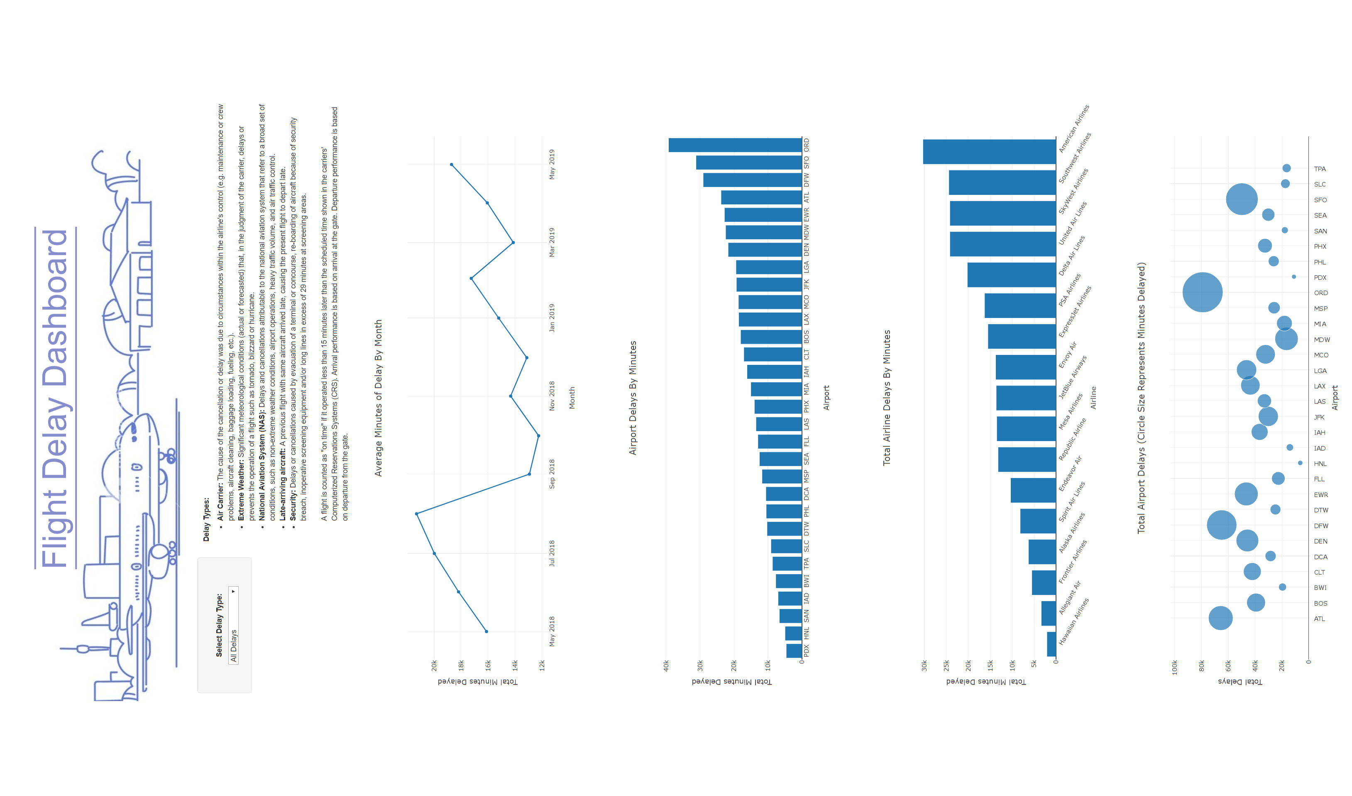
SIDEWAYS DASHBOARD: ALL VISUALIZATIONS

Slide 7
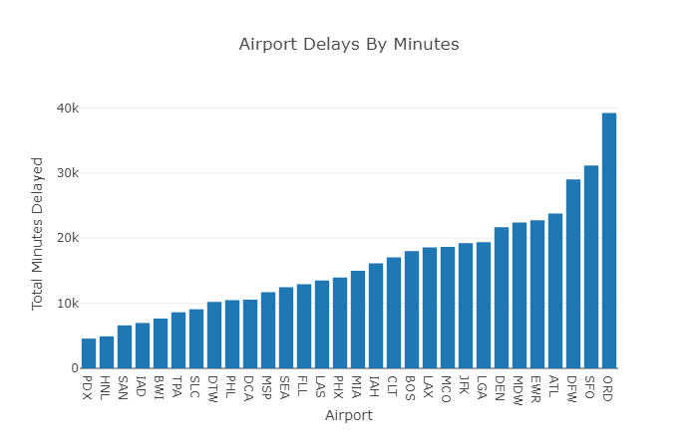
Final Viz: airport delays

Slide 8
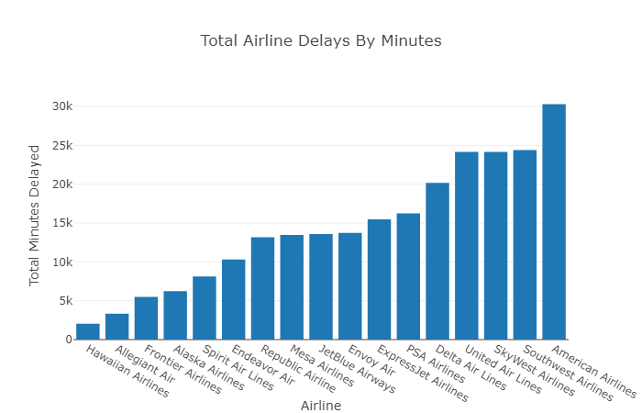
Final viz: airline delays

Slide 9
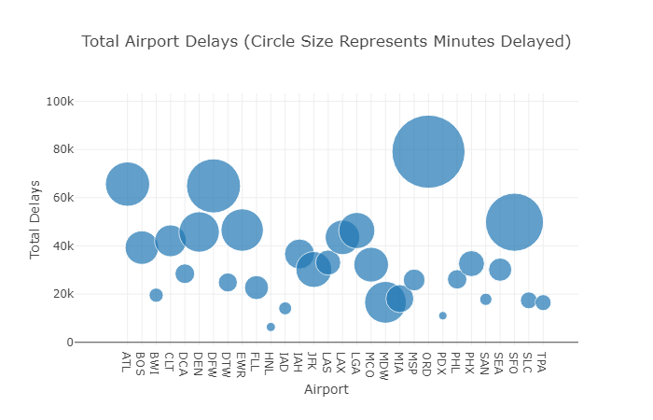
Final viz: delays by frequency and duration

Slide 10
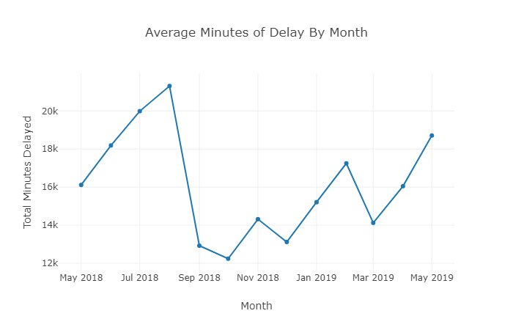
Final viz: Delays by month

Slide 11
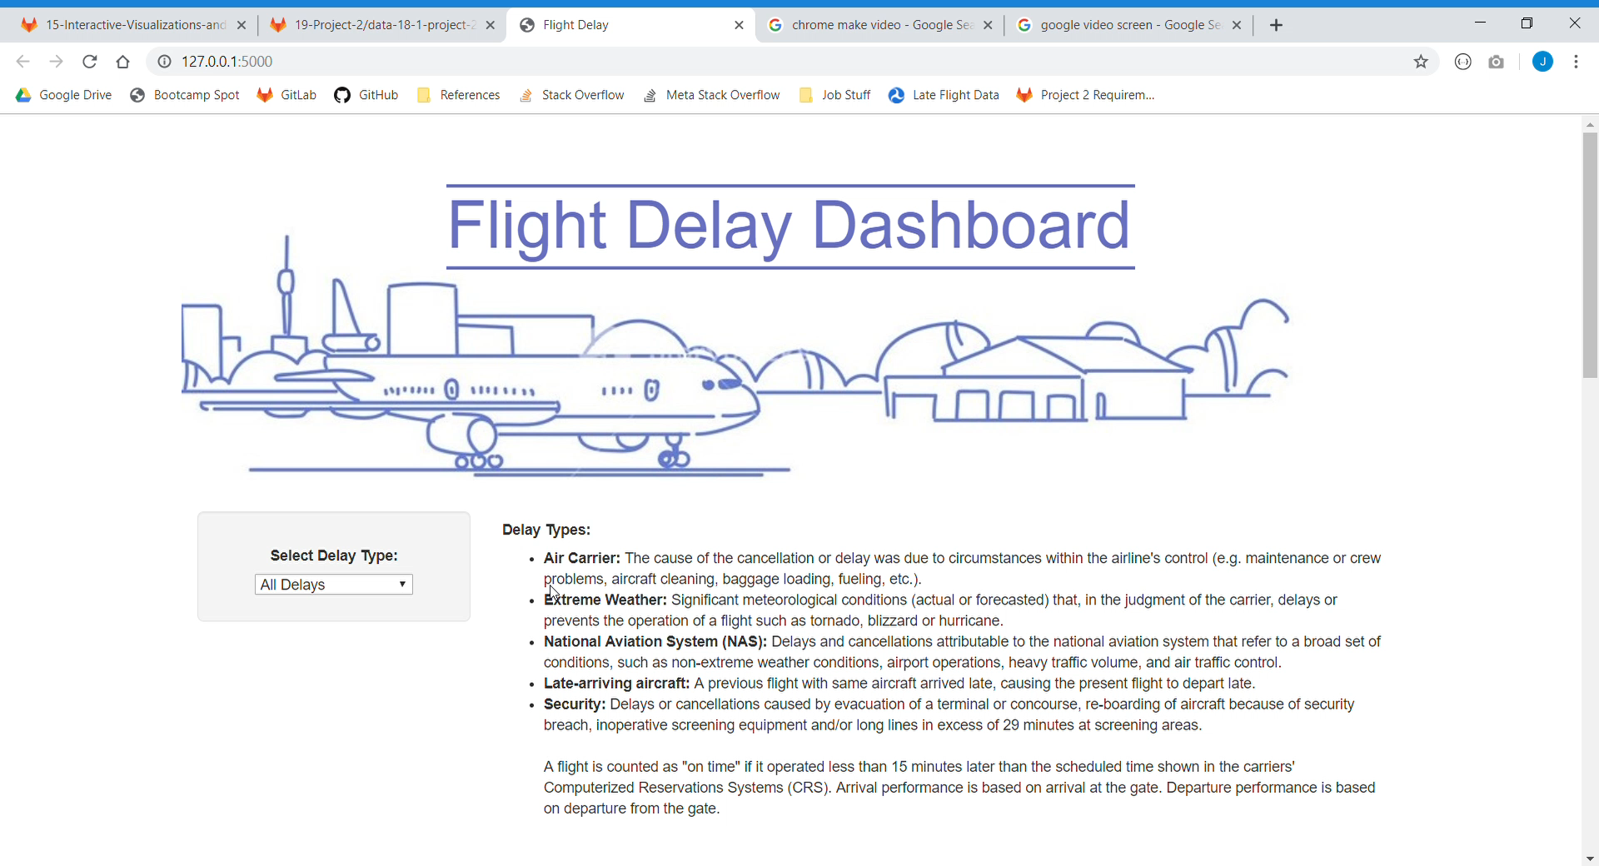
anime.js

